Slide 1
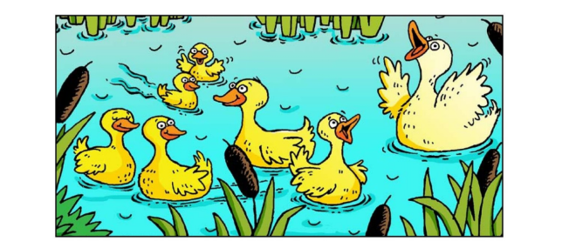
Pond Animals

Slide 2
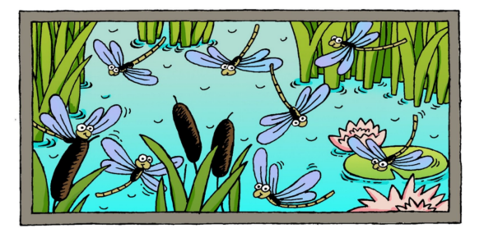
I see eight bugs.

Slide 3
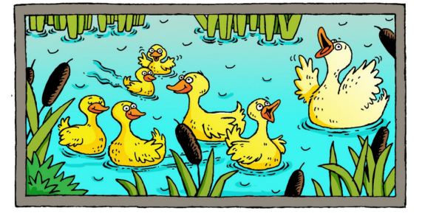
I see seven ducks.

Slide 4
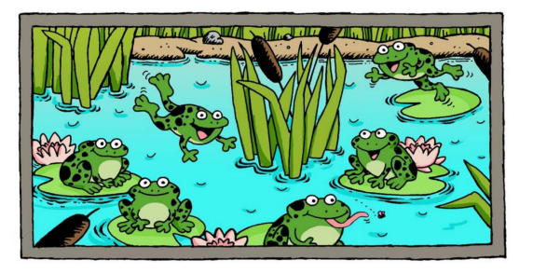
I see six frogs.

Slide 5
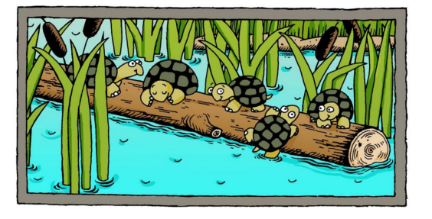
I see five turtles.

Slide 6
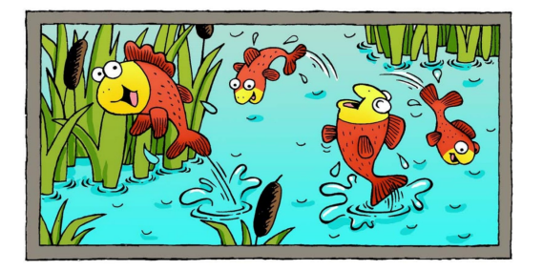
I see four fish.

Slide 7
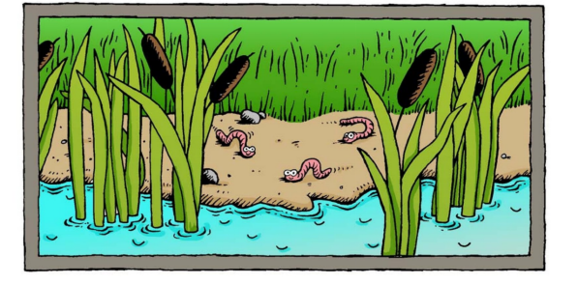
I see three worms.

Slide 8
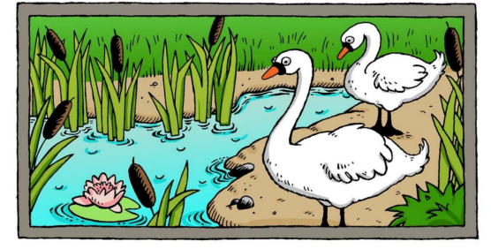
I see two swans.

Slide 9
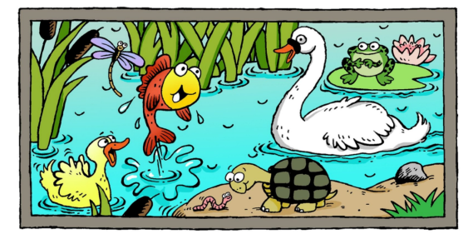
I see one pond.

Slide 10
Eight
Seven
Six
Four
Five
Three
Two
One
Click on the colored stars to start getting to know them!

Slide 11
RETURN
I see eight bugs.

Slide 12
RETURN
I see seven ducks.

Slide 13
RETURN
I see six frogs.

Slide 14
RETURN
I see five turtles.

Slide 15
RETURN
I see four fish.

Slide 16
RETURN
I see three worms.

Slide 17
RETURN
I see two swans.

Slide 18
RETURN
I see one pond.

